Slide 1
INVESTMENT CASE STUDY SUBMISSION
Group Name: Group PISA
Anjali
Prateek Pathak
Gyaneshwari S
Santoshkumar Tuppad

Slide 2
Abstract
Problem Statement:
XYZ company employs around 4000 employees. However, every year, around 15% of its employees leave the company and need to be replaced with the talent pool available in the job market. The management believes that this level of attrition(employees leaving, either on their own or because they got fired) is bad for the company because of the following reasons -
The former employees’ projects get delayed, which makes it difficult to meet timelines, resulting in a reputation loss among consumers and partners.
A sizeable department has to be maintained, for the purposes of recruiting new talent.
More often than not, the new employees have to be trained for the job and/or given time to acclimatize themselves to the company
Objectives of the Analysis:
Model the probability of attrition using a logistic regression.
Identify changes they should make to their workplace, in order to get most of their employees to stay.
Solution Approach:
R is used for Data preparation, from raw data sources.

Slide 3
Data Cleaning Approach
Remove all the columns which have 'NA' or 0 values.
Remove all the columns which have only 1 value throughout.
Remove all the columns which are redundant for analysis.
Calculate Daily Average hours spent in office from In and Out time sheets.
Derive new columns for further analysis.
Employee Satisfaction: Sum of all employee survey data for each employee. As a continuous variable gives more scope for analysis
Manager Survey: Sum of all manager survey data.
Overtime (Yes/No) : If employee is spending more than the standard time of 8 hrs in office.

Slide 4
Data Description
Data contains 4410 unique employee loan data.
Two Timesheets are provided for In and Out time of employee.
Employee survey data is provided.
Manager Survey data is provided.
The employee data is quite unbalanced for modeling with only 16% employees leaving.
NOTE : After complete univariate and bivariate analysis following slides showcase the highlights. Rest of the plots and analysis summary can be looked up in R file.

Slide 5
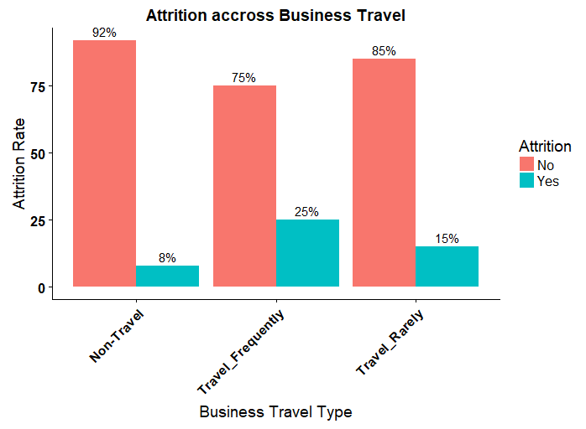
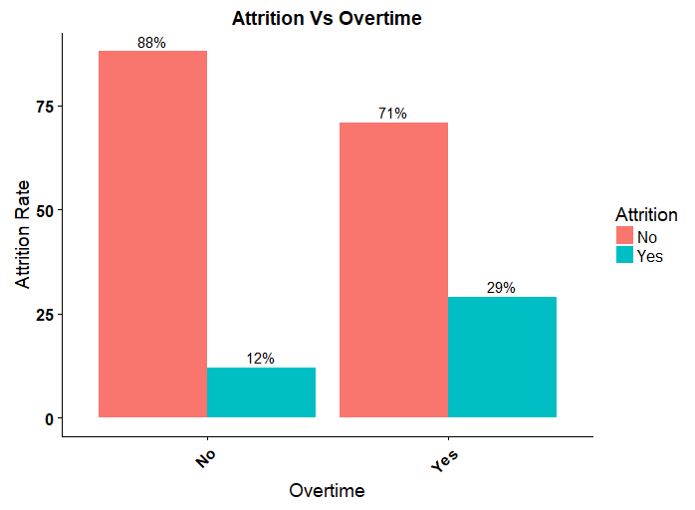
Univariate Analysis – Exhibit 1
Business Travel: Employee who have to travel frequently have a high rate of attrition.
Employees spending more than standard hours in office i.e overtime have a higher tendency to leave.

Slide 6
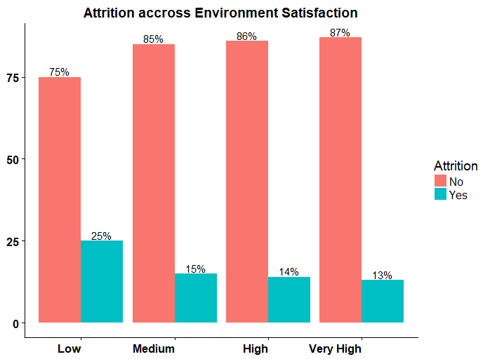
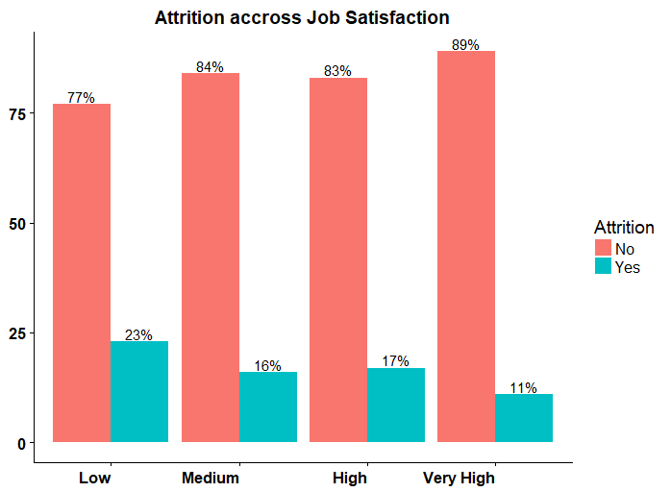
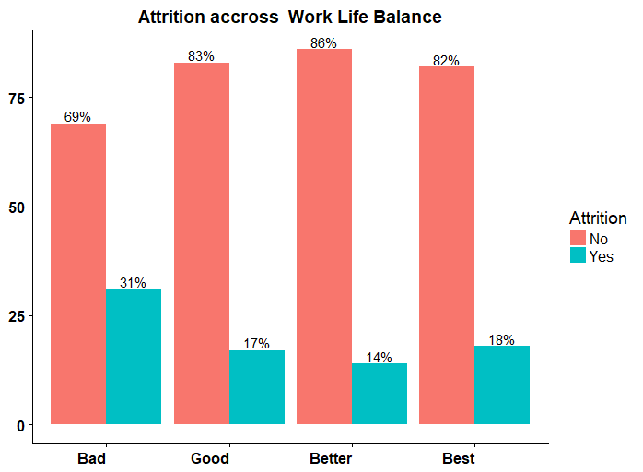
Univariate Analysis – Exhibit 2
Across all categories of Employee survey, employees responding poorly to survey have a higher attrition rate.

Slide 7
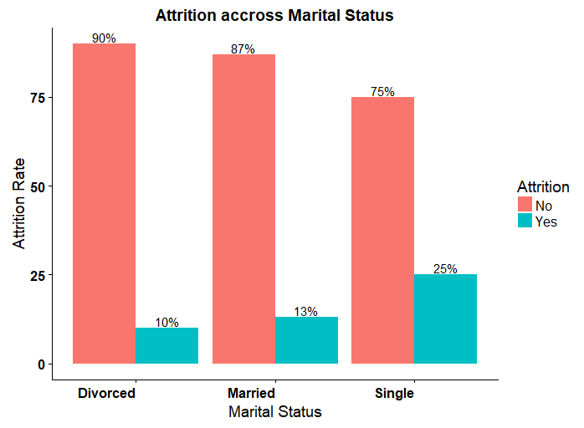
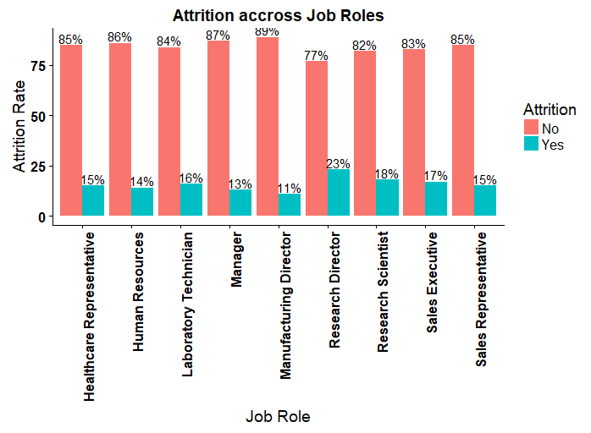
Univariate Analysis – Exhibit 3
Employees who are single have a much higher attrition rate as compared to marriage and divorced.
Job Role research director shows a little higher attrition rate.

Slide 8
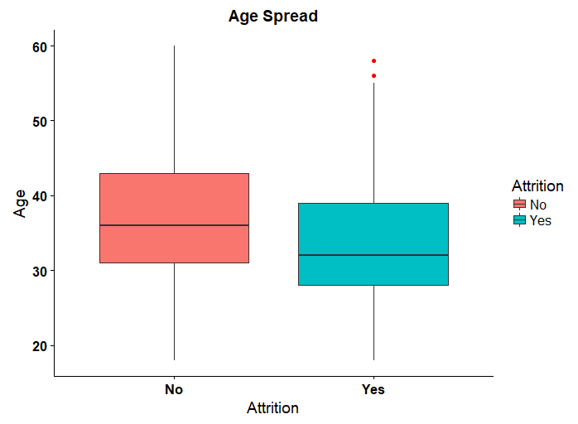
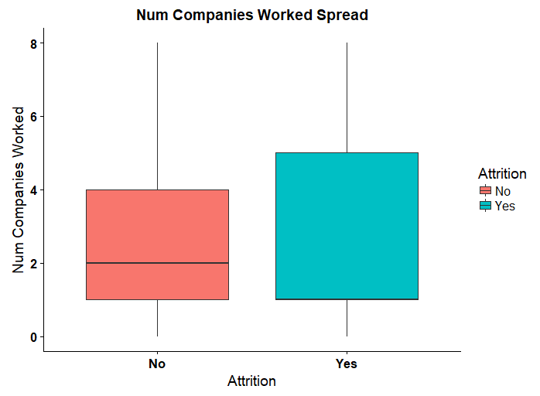
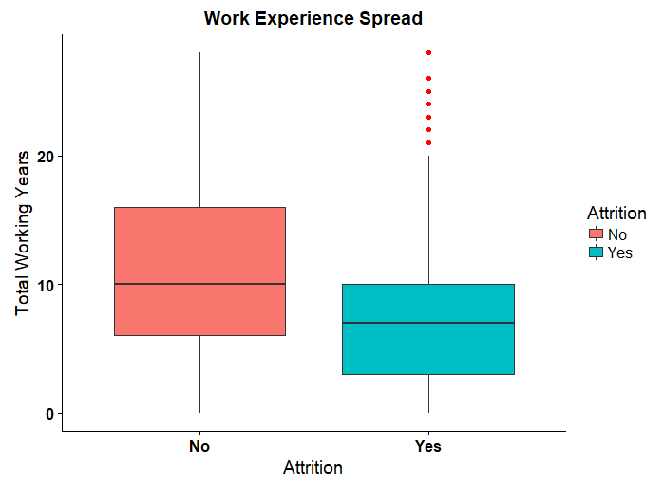
Univariate Analysis – (Continuous)
Age: Employees leaving the org definitely show a much lower median of Age.
Fresher's and employees with less experience clearly have a higher tendency to leave.

Slide 9
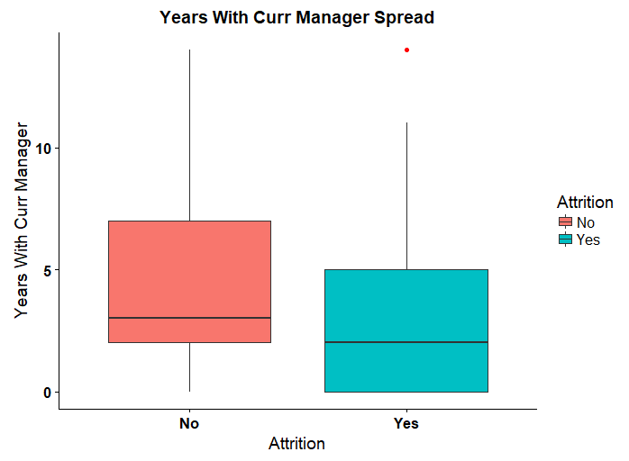
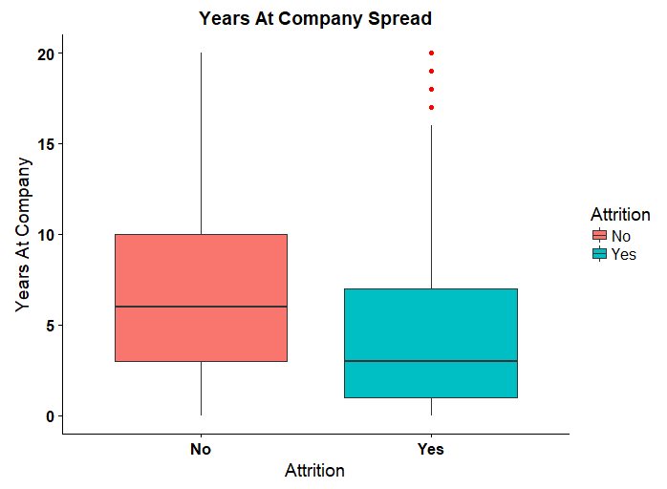
Univariate Analysis - (Continuous)
Employees under the same manager for longer time tend to stay more in the company.
Employees leaving the company spend lesser time in the org as compared to ones that are not leaving.

Slide 10
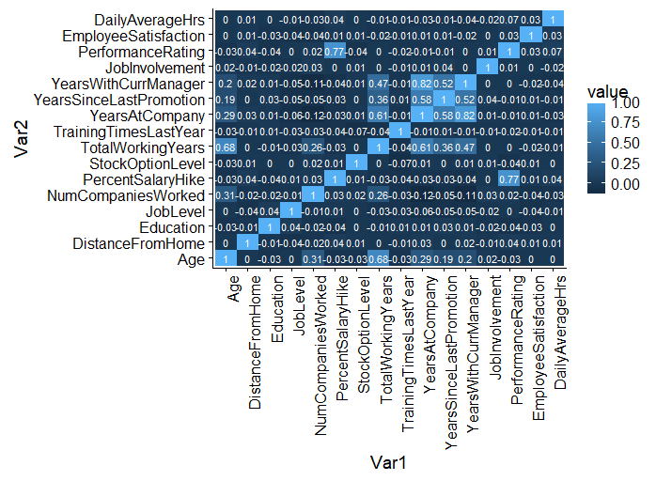
Bivariate Analysis
Conclusions:
Performance rating is highly correlated to salary hike.
Years with current manager and years at company are highly correlated.
Age, Total working years and years at company are highly correlated.

Slide 11
Logistic regression
Steps:

Slide 12
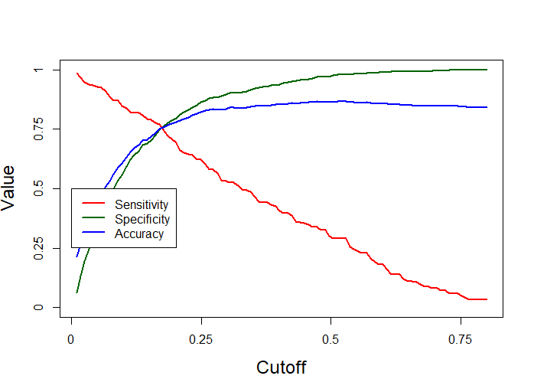
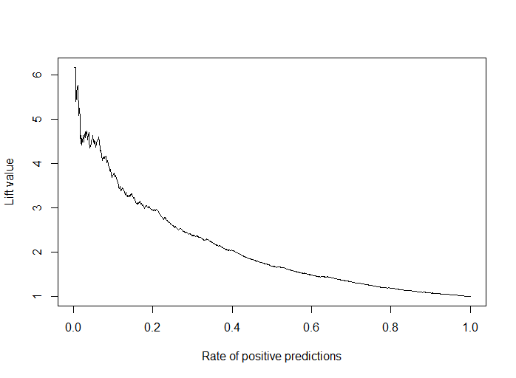
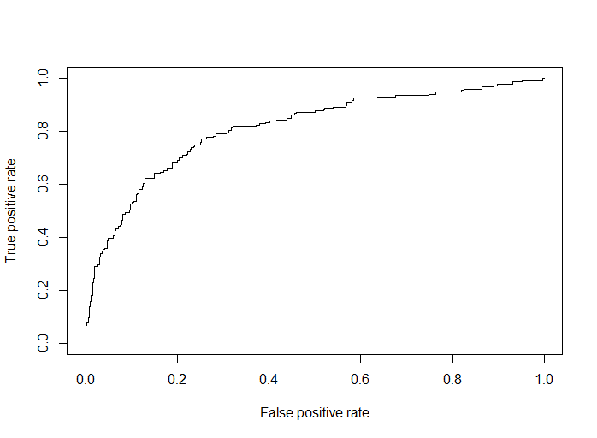
Gain And Lift Plots
Summary:
The ideal cut off comes at 17.75%.
ROC comes at 0.81 which is a good value.

Slide 13
Model Evaluation- K-Stats
Summary:

Slide 14
Conclusions Recommendations
Variables affecting Employee Attrition

